Slide 1
Course Computer Vision AMSE -2024
"This document is the property of AIRBUS, no part of it shall be reproduced or transmitted without express prior written authorization of AIRBUS and its contents shall not be disclosed". © AIRBUS 2024

Slide 2
Course Objective
The objective of this course is to provide participants with a comprehensive understanding of computer vision by covering both foundational and advanced techniques.
By the end of the course, you will:
Understand key image processing concepts such as filtering, feature extraction, and segmentation.
Gain hands-on experience with tools like OpenCV and Python for image manipulation and analysis.
Explore advanced topics, including deep learning, convolutional neural networks (CNNs), and object detection.
Develop the skills to apply computer vision techniques to real-world problems such as object recognition, image classification, and segmentation.

Slide 3
Chapter 1: Introduction to Computer Vision
AMSE - Course on Computer Vision - 2024

Slide 4
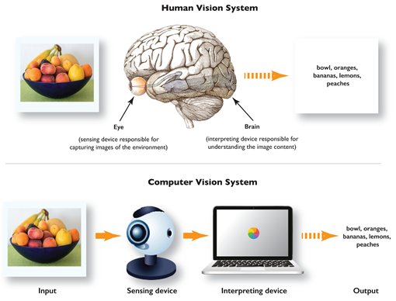
What is Computer Vision (CV) ?
Definition: Computer Vision is a field of artificial intelligence (AI) that enables machines to interpret and understand visual information from the world, such as images and videos. By simulating human vision, computer vision systems can analyze and extract meaningful insights from visual data, allowing machines to perform tasks that typically require human visual perception.

Slide 5
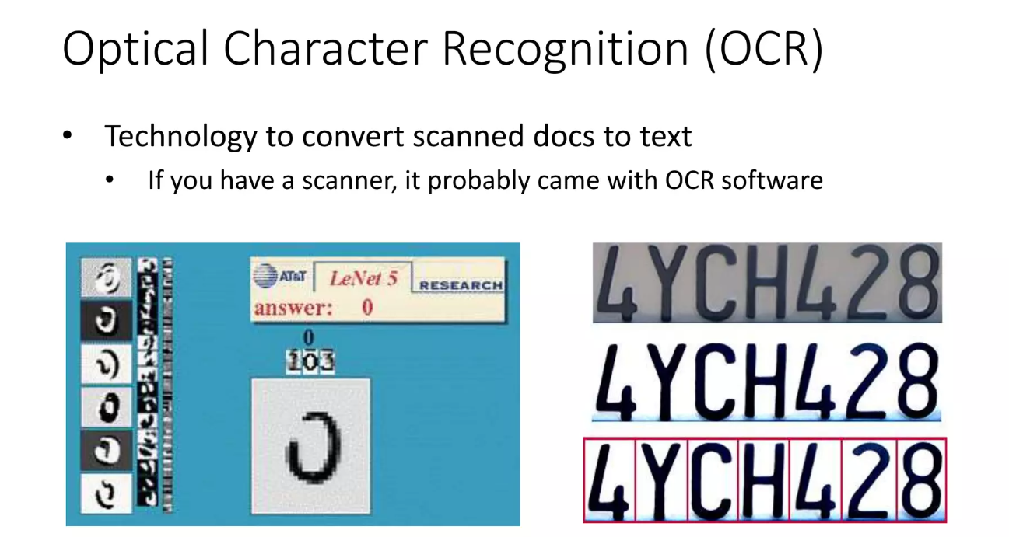
Applications of Computer Vision ?

Slide 6
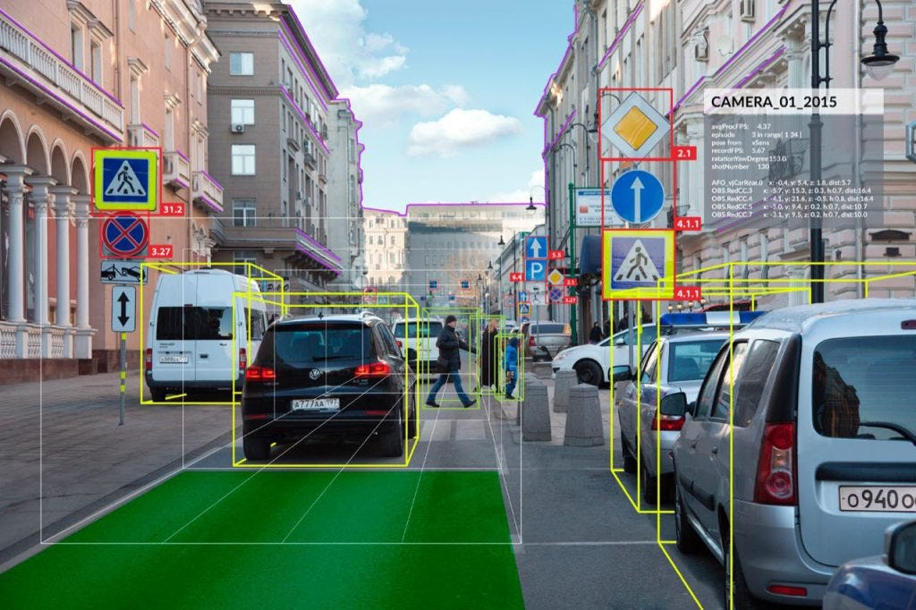
Applications of Computer Vision ?
Autonomous Vehicles

Slide 7
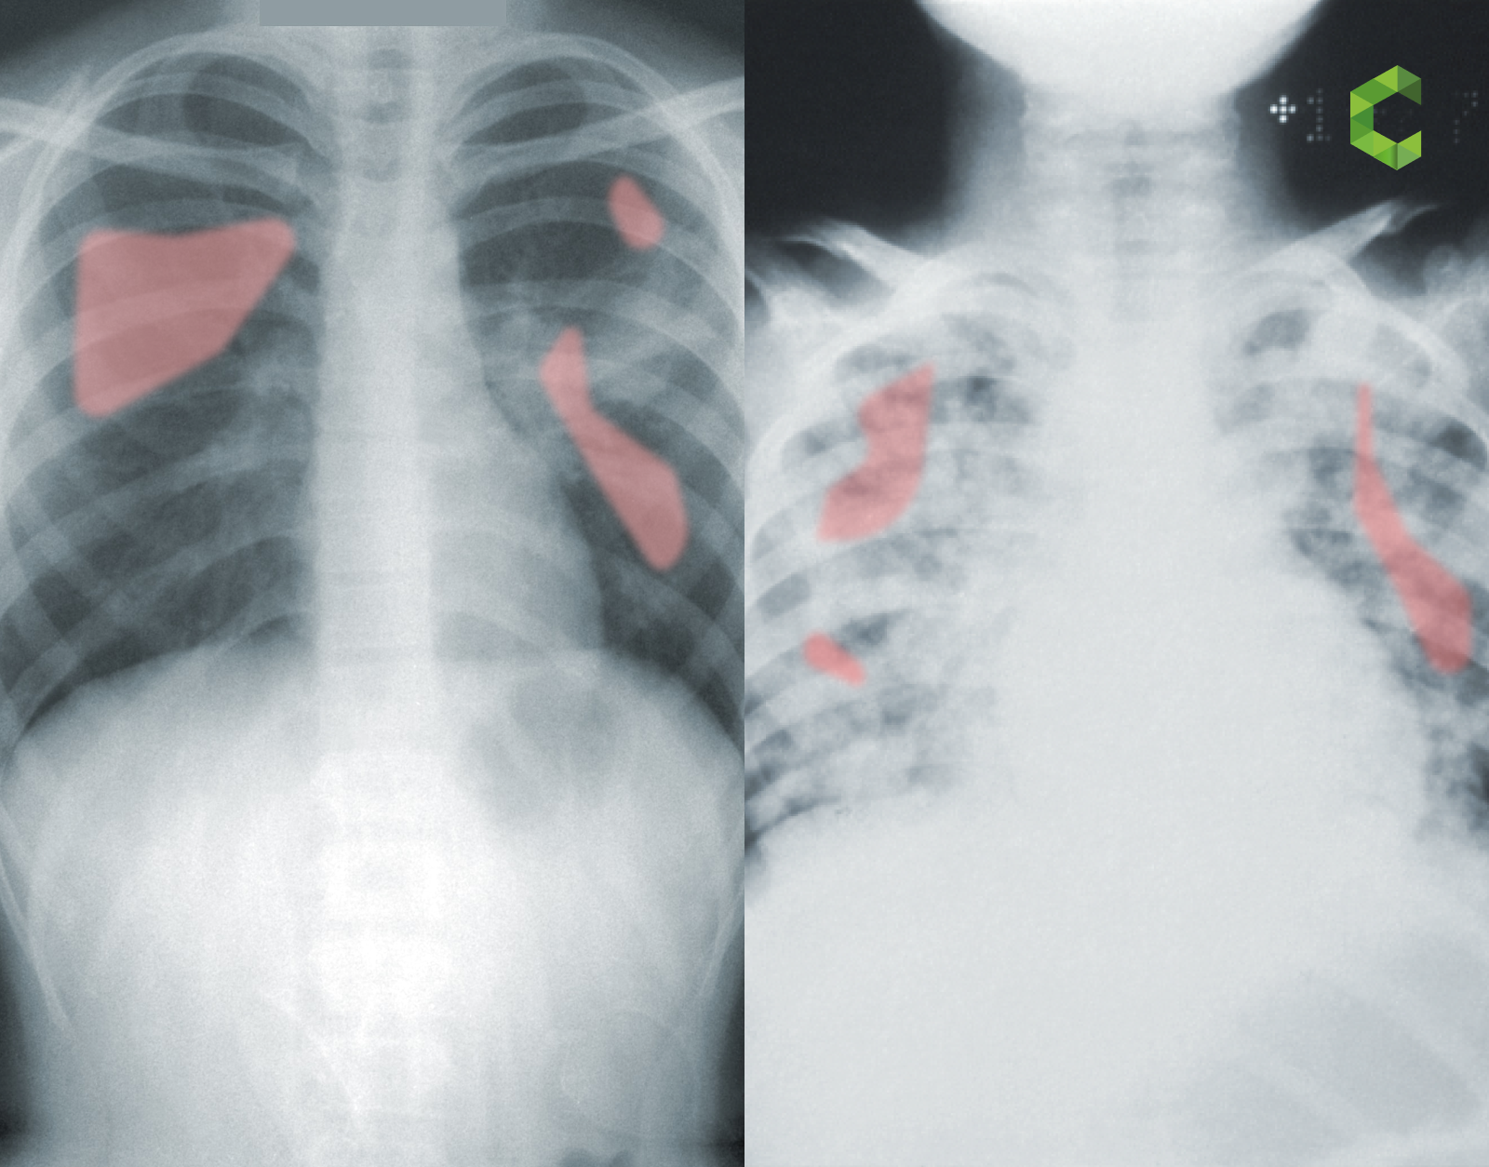
Applications of Computer Vision ?
Medical Imaging

Slide 8
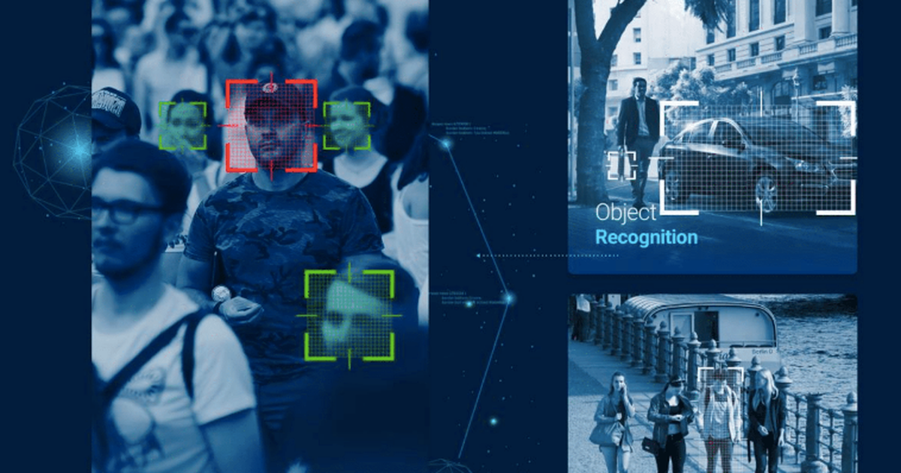
Applications of Computer Vision ?
Security and Surveillance

Slide 9
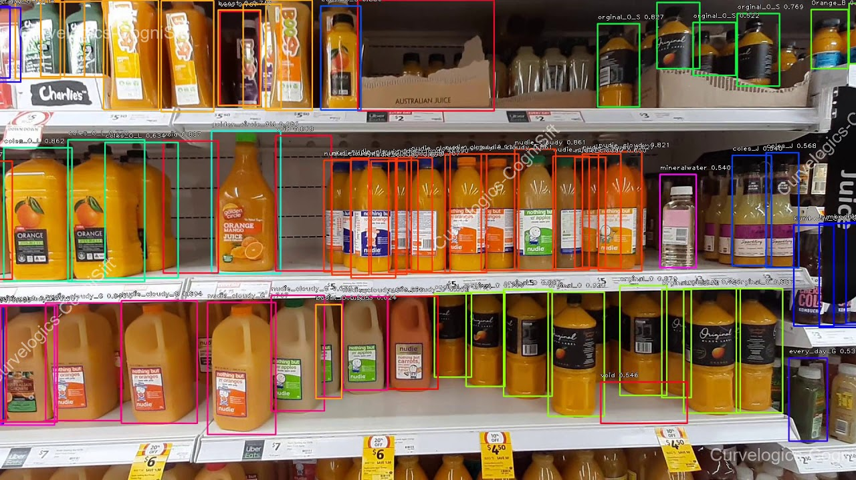
Applications of Computer Vision ?
Retail and Inventory Management

Slide 10
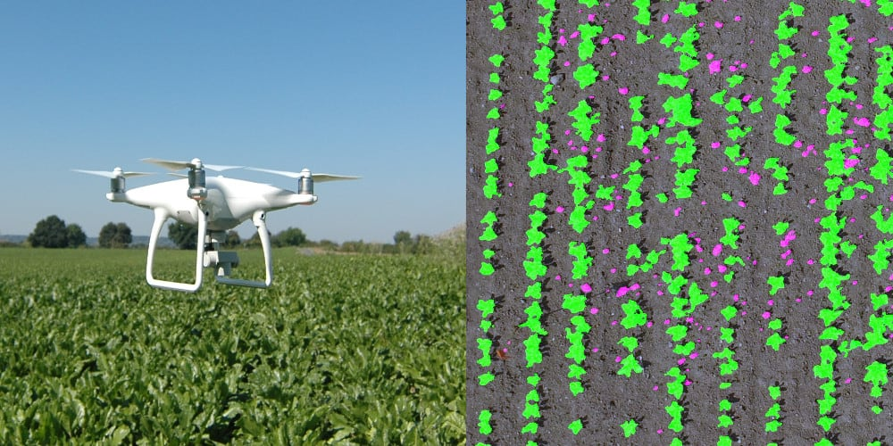
Applications of Computer Vision ?
Agriculture

Slide 11

Applications of Computer Vision ?
Augmented and Virtual Reality (AR/VR):

Slide 12
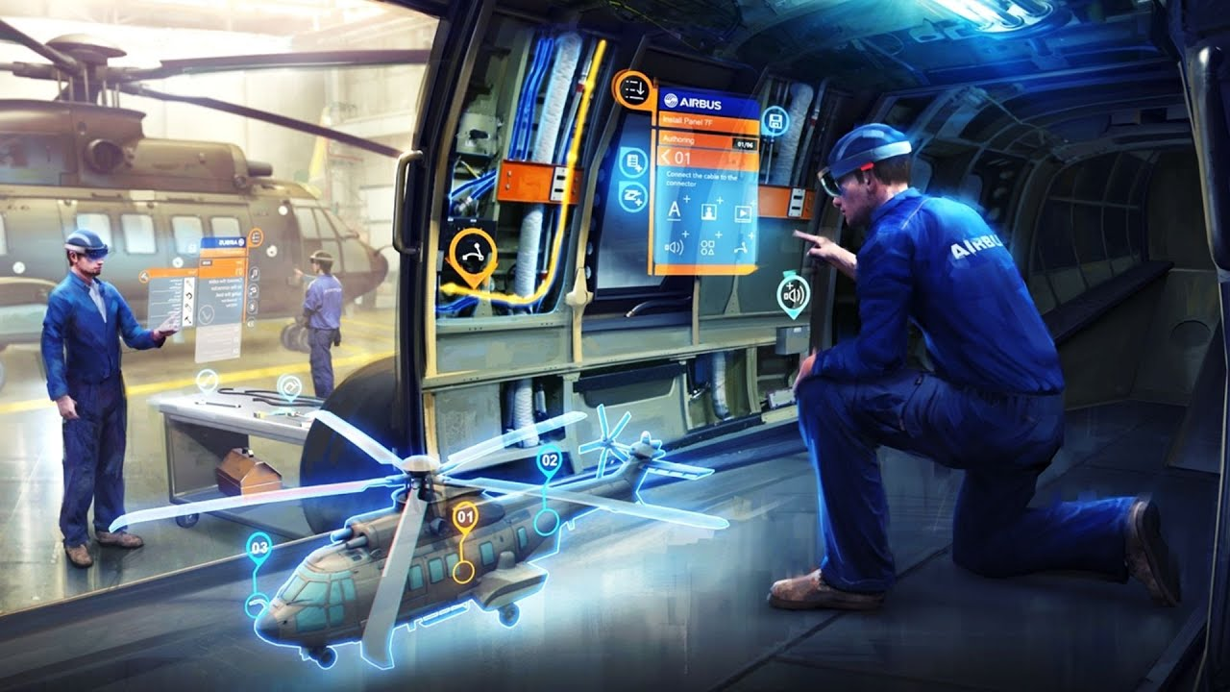
Applications of Computer Vision ?
Augmented and Virtual Reality (AR/VR):

Slide 13
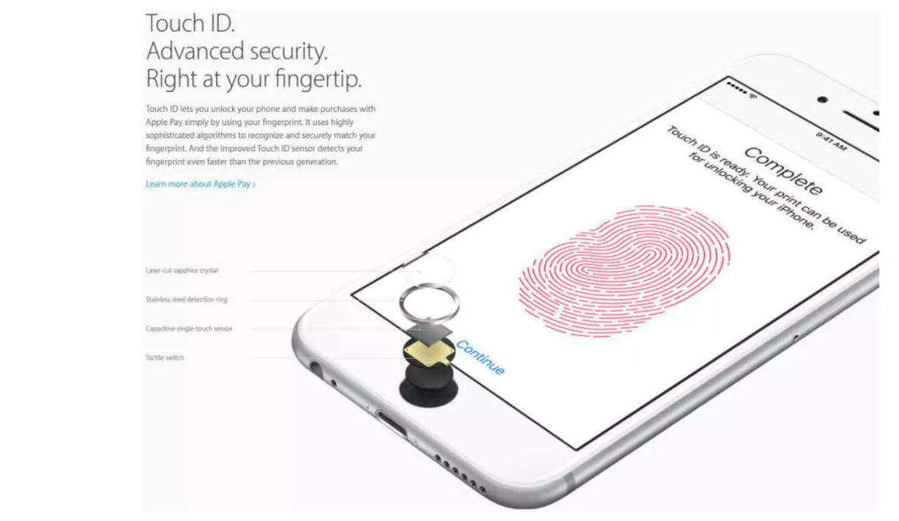
Applications of Computer Vision ?
Fingertip Recognition

Slide 14
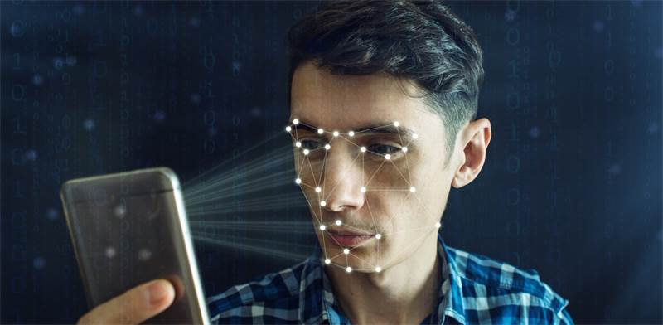
Applications of Computer Vision ?
Facial Recognition

Slide 15
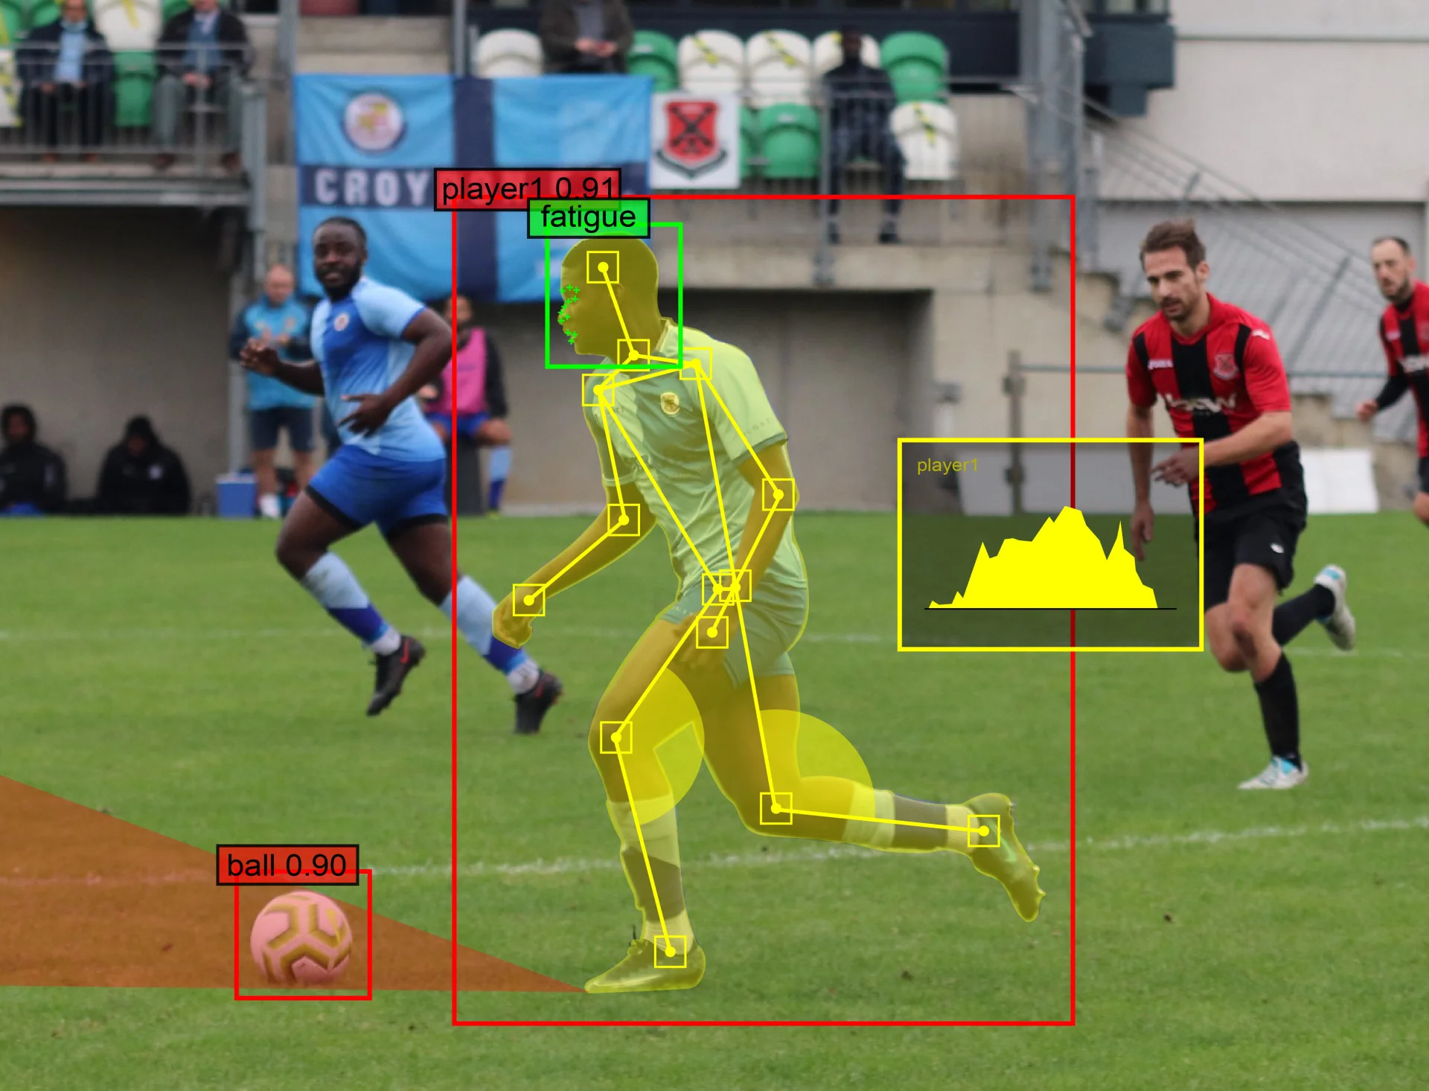
Applications of Computer Vision ?
Sports Analytics

Slide 16

Defects Detection in Rotor Composite Parts using A.I.
Applications of Computer Vision ?
Manufacturing and Quality Control

Slide 17

01
Background
"This document is the property of AIRBUS, no part of it shall be reproduced or transmitted without express prior written authorization of AIRBUS and its contents shall not be disclosed". © AIRBUS 2024

Slide 18
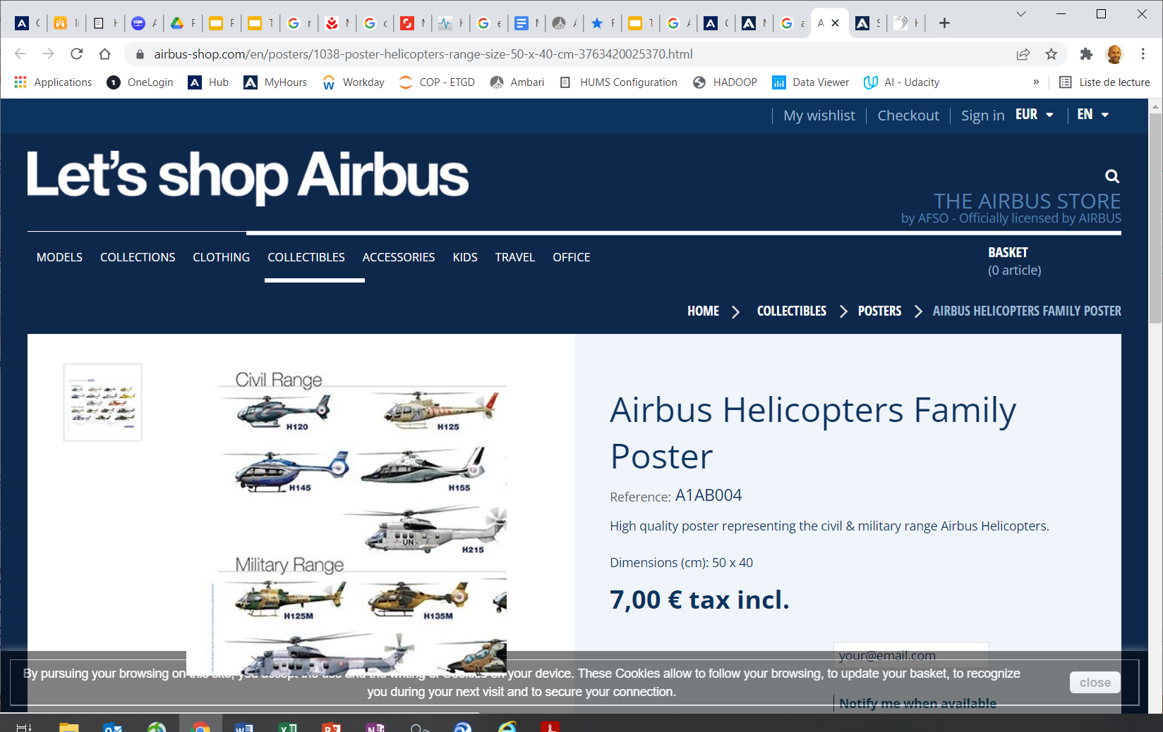
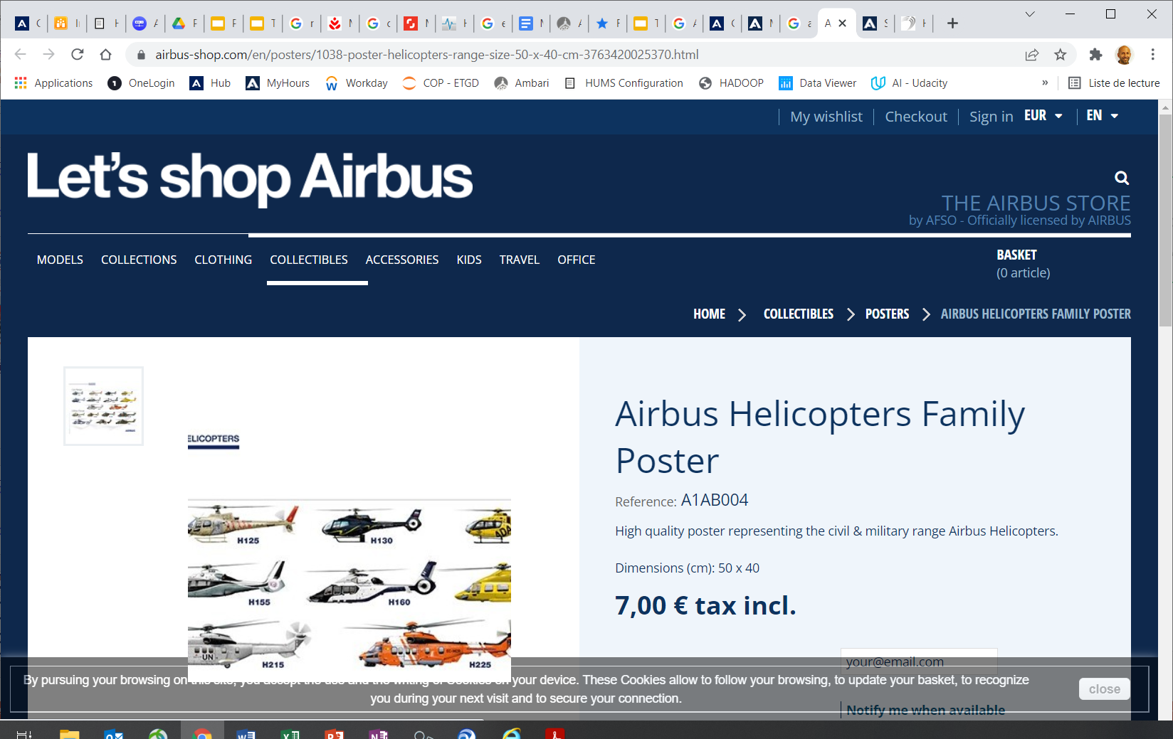
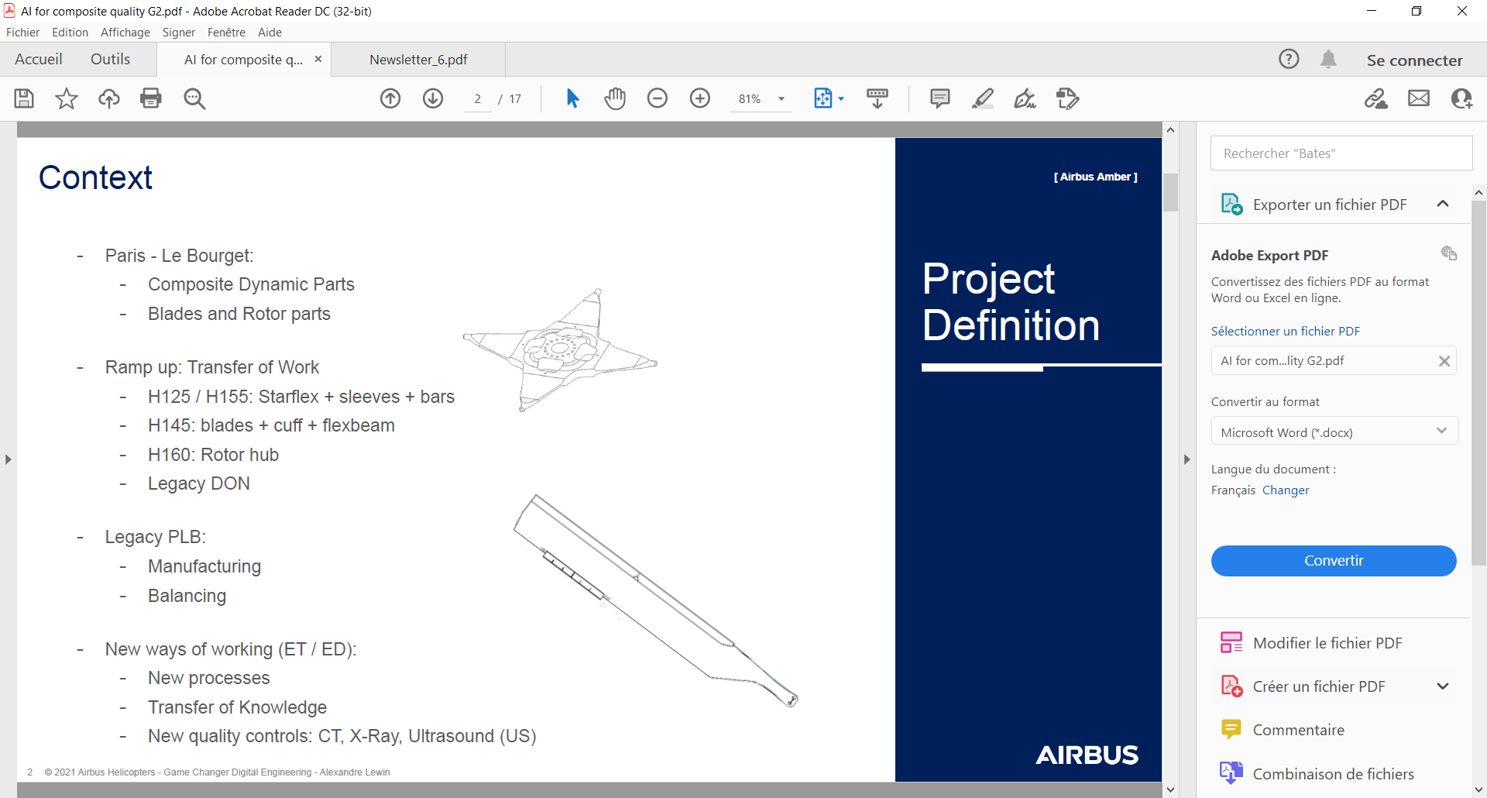

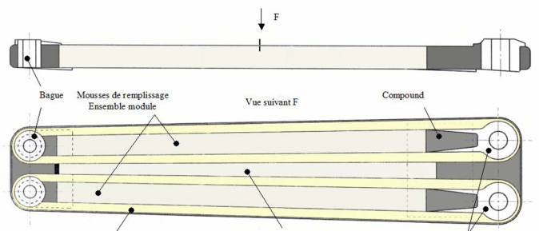
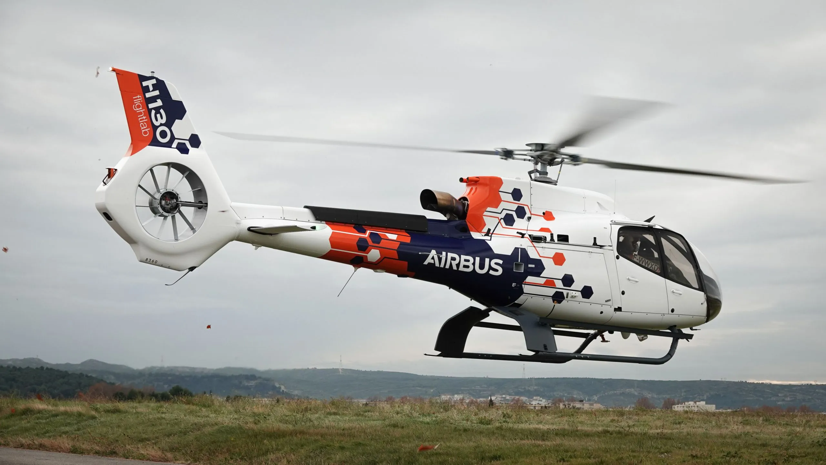
COMPOSITE PART on Aircrafts
STARFLEX (HUB)
SLEEVE
BLADE
Data
"This document is the property of AIRBUS, no part of it shall be reproduced or transmitted without express prior written authorization of AIRBUS and its contents shall not be disclosed". © AIRBUS 2024

Slide 19
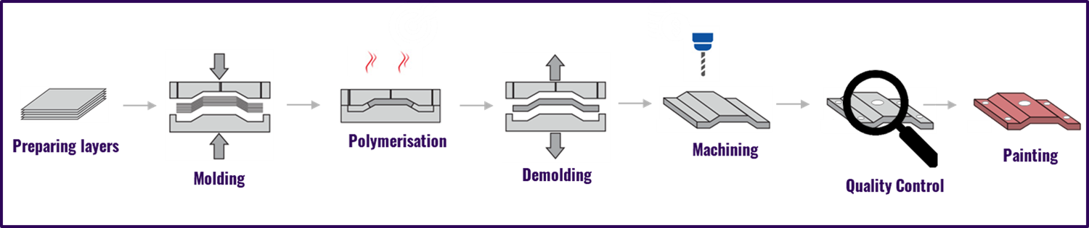
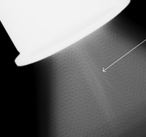
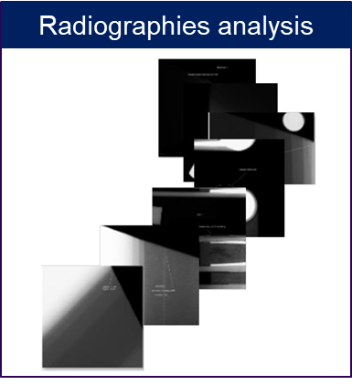
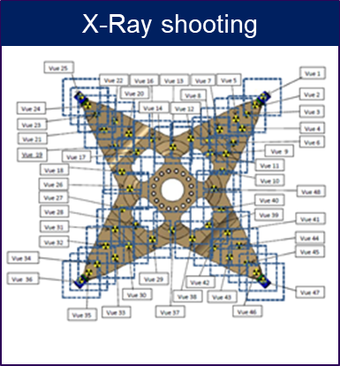
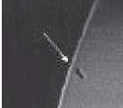
COMPOSITE PART Manufacturing
STARFLEX (HUB)
Defect
Defect
20 differents type of defects
Defect
"This document is the property of AIRBUS, no part of it shall be reproduced or transmitted without express prior written authorization of AIRBUS and its contents shall not be disclosed". © AIRBUS 2024

Slide 20
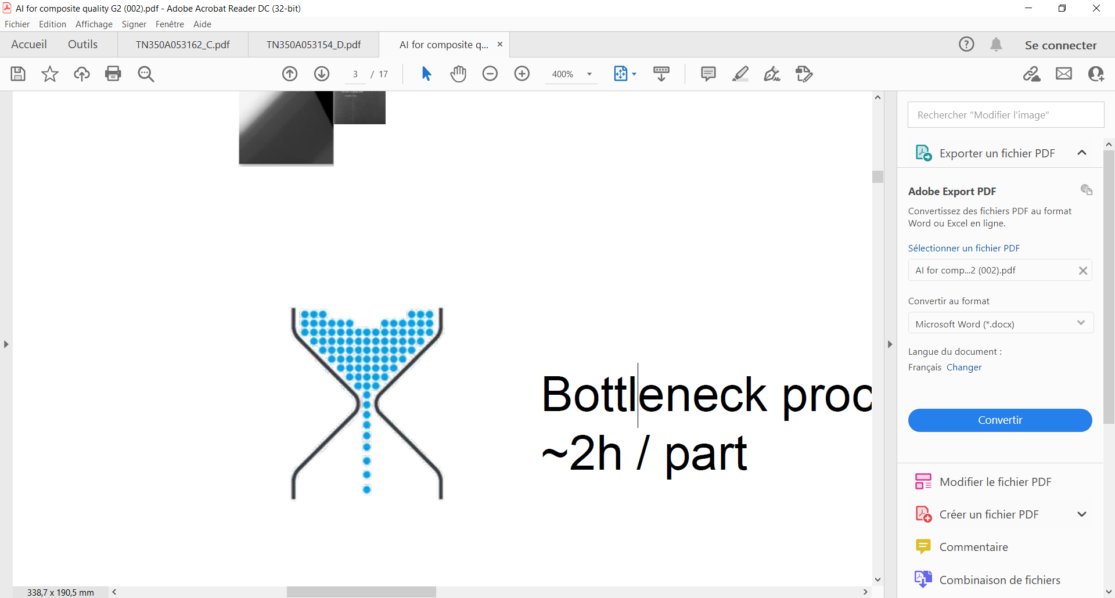
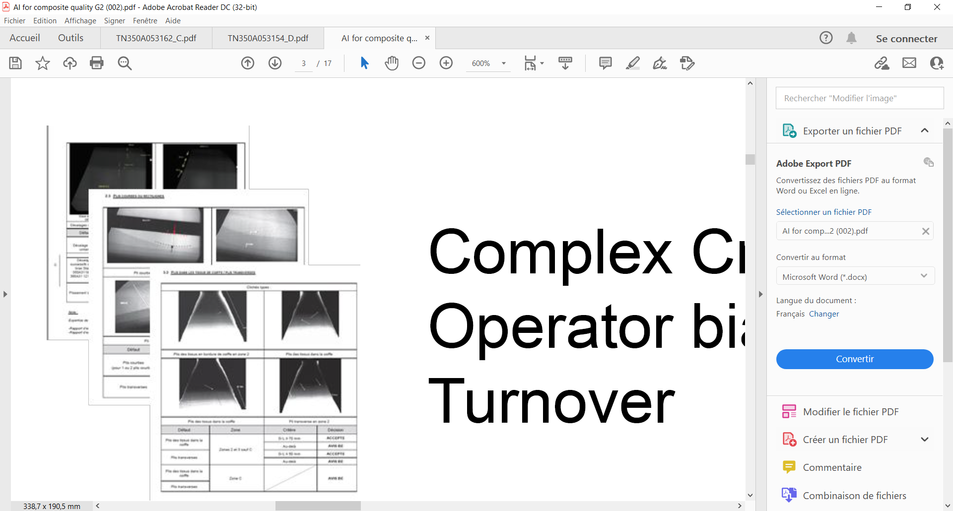
QUALITY CONTROL - Current Situation
Time consuming process
Up to 50 images for 1 part
~1h / part
100 000 images / year
Bottleneck situation
Big batch produced at once
Crisis mode (when many defects)
Human Dependent
Skilled Qualified Inspector
Complex criteria interpretation
Human detection bias
"This document is the property of AIRBUS, no part of it shall be reproduced or transmitted without express prior written authorization of AIRBUS and its contents shall not be disclosed". © AIRBUS 2024

Slide 21
02
Using A.I.
"This document is the property of AIRBUS, no part of it shall be reproduced or transmitted without express prior written authorization of AIRBUS and its contents shall not be disclosed". © AIRBUS 2024

Slide 22

DEFECT DETECTION on RADIOSCOPIES using AI
Automatic defects detection
using Artificial Intelligence (AI)
Defect
Defect
Defect
Defect
Defect
Defect
Defect
"This document is the property of AIRBUS, no part of it shall be reproduced or transmitted without express prior written authorization of AIRBUS and its contents shall not be disclosed". © AIRBUS 2024

Slide 23
03
How ?
"This document is the property of AIRBUS, no part of it shall be reproduced or transmitted without express prior written authorization of AIRBUS and its contents shall not be disclosed". © AIRBUS 2024

Slide 24
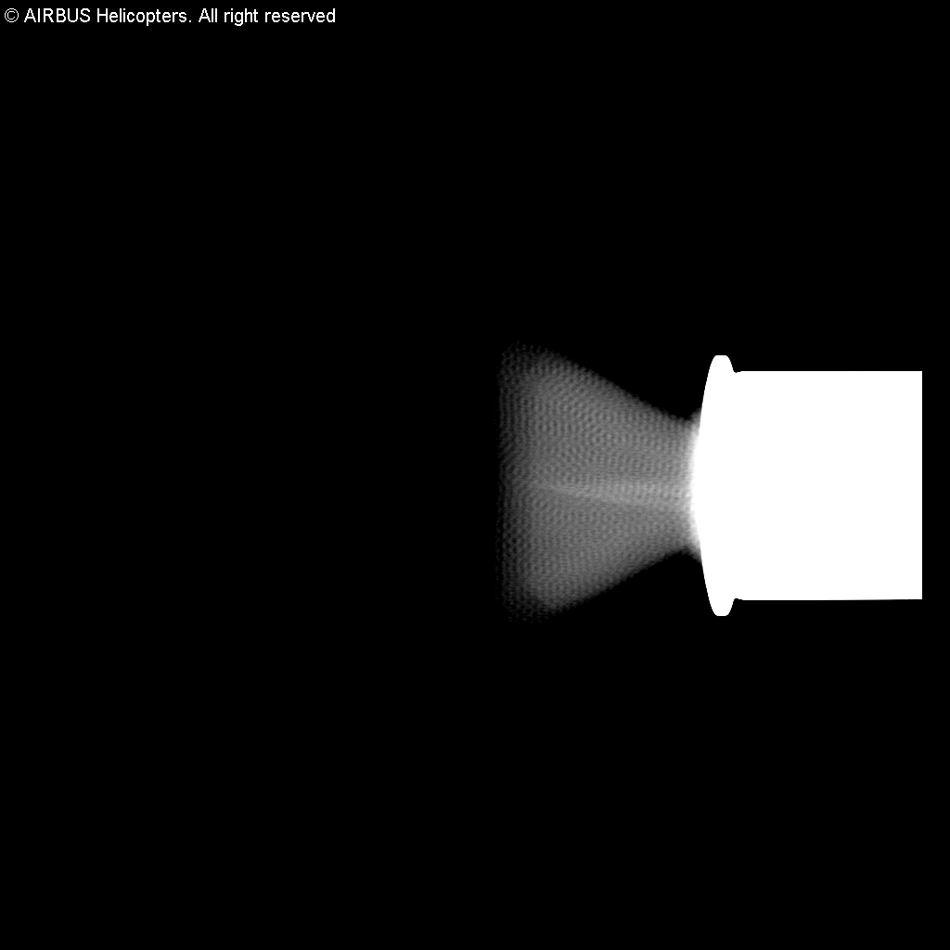
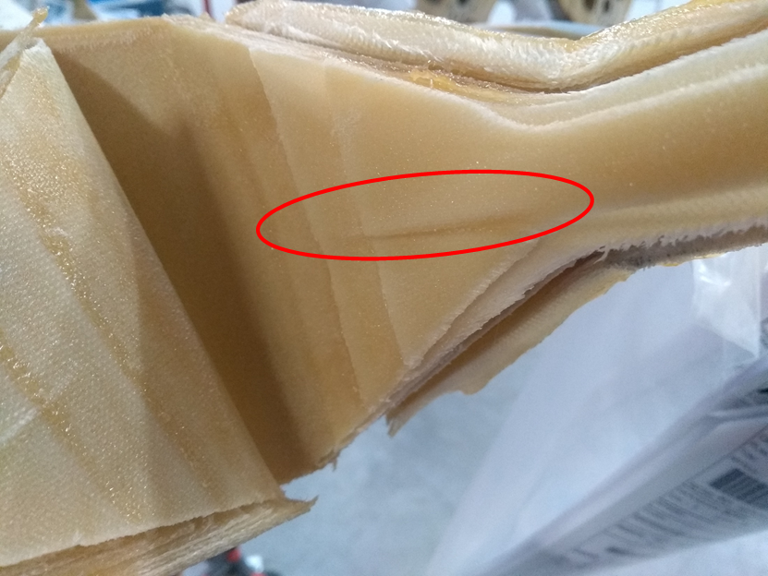
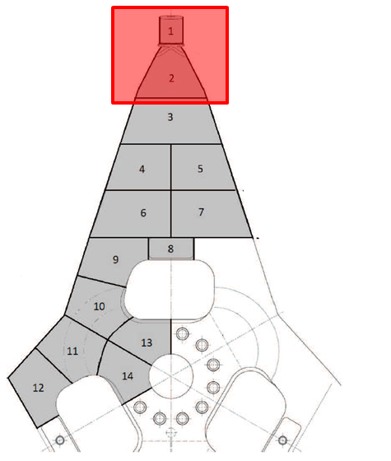
DEFECT DETECTION on RADIOSCOPIES using AI
Defect considered : wrinkle (out of plane ripple)
24
"This document is the property of AIRBUS, no part of it shall be reproduced or transmitted without express prior written authorization of AIRBUS and its contents shall not be disclosed". © AIRBUS 2024

Slide 25
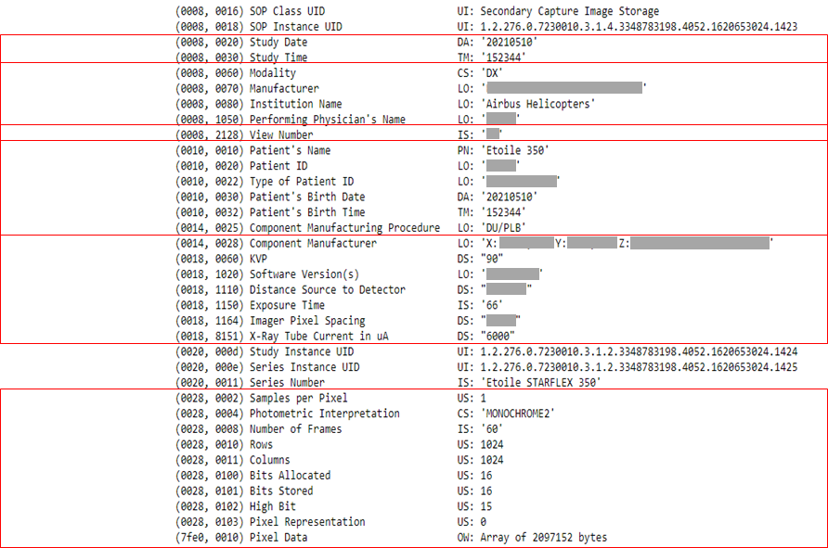

DEFECT DETECTION on RADIOSCOPIES using AI
Meta data
Image
DICOM file format :
Date and Time of picture
Machine used, Company, Operator…
View Number
Info on part
Info on X-Ray shooting parameters
Info on picture output parameters
Grayscale image, 1024 x 1024 pixels, 16 bits
PNG format (lossless format)
25
"This document is the property of AIRBUS, no part of it shall be reproduced or transmitted without express prior written authorization of AIRBUS and its contents shall not be disclosed". © AIRBUS 2024

Slide 26
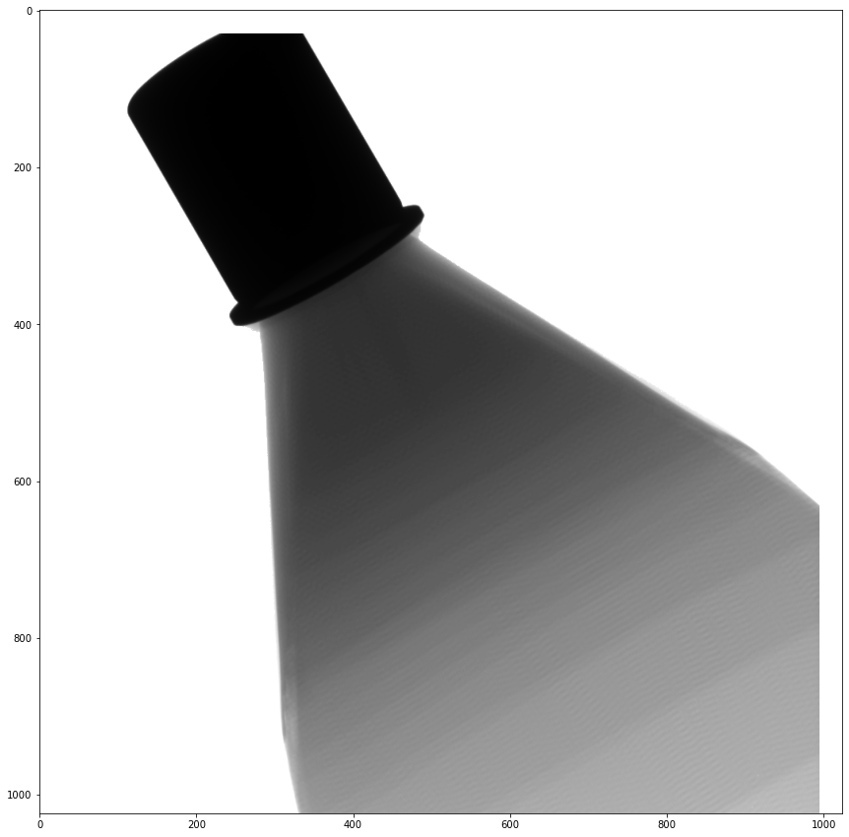
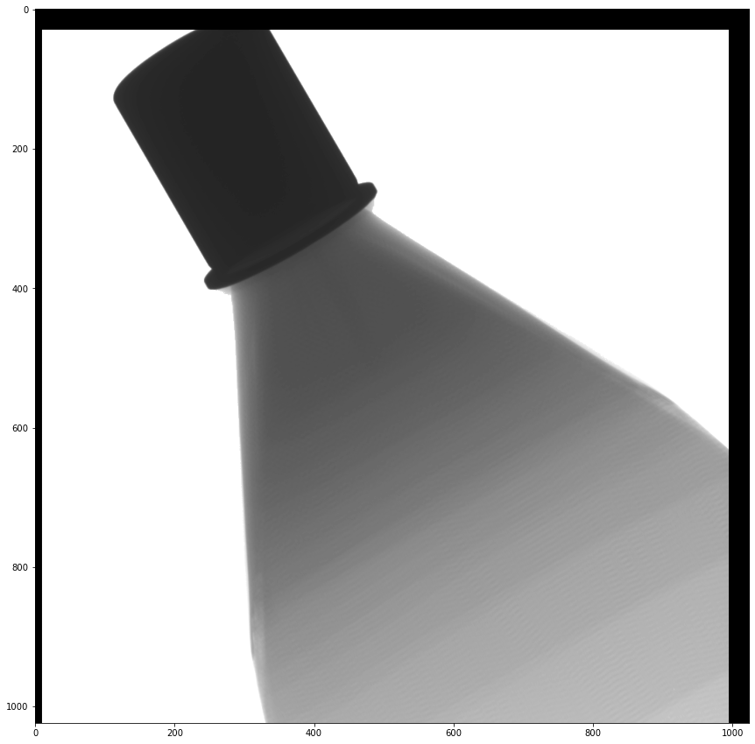
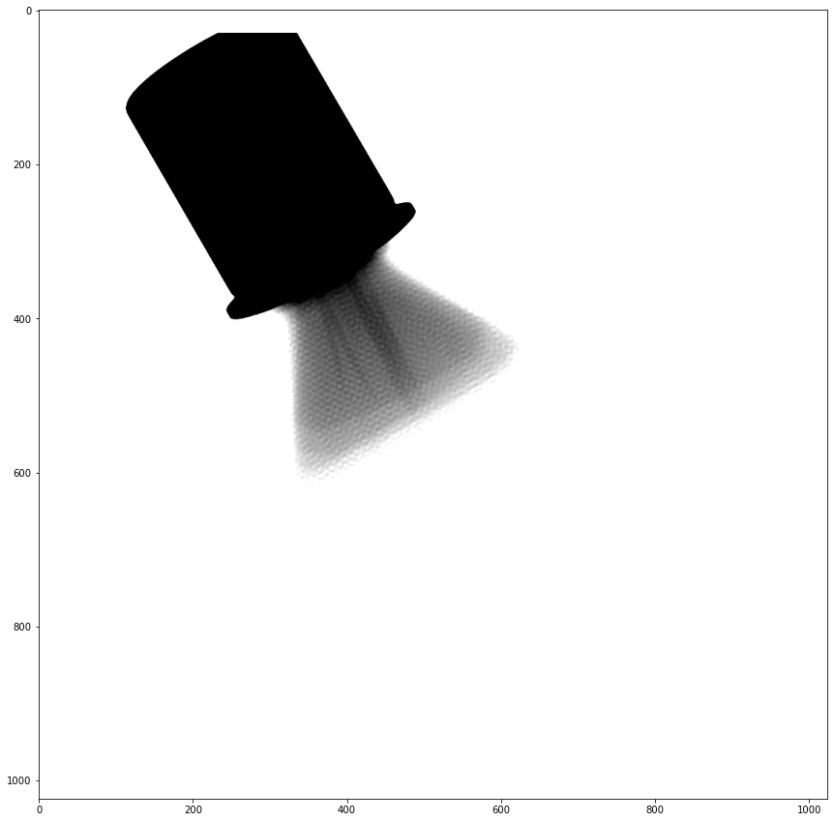
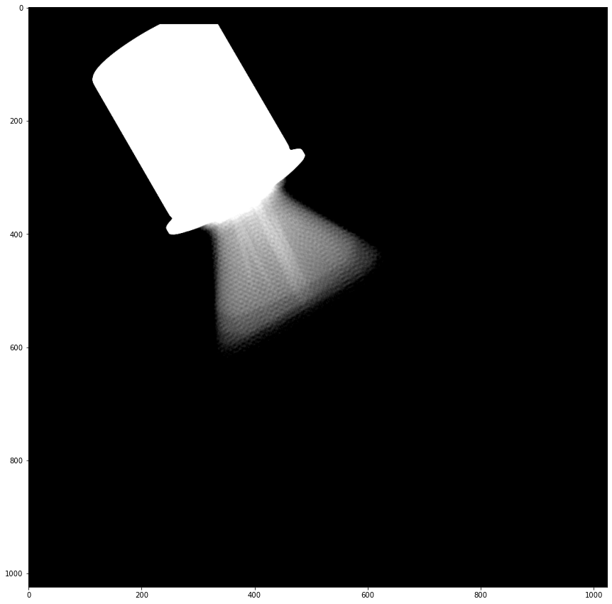
DEFECT DETECTION on RADIOSCOPIES using AI
Images Database
DICOM files
Image Pre-treatment
Extract images in PNG format (16 bits) ► each pixel can have a value between 0 and 65535
Remove black borders
Filter intensity range
= intensity where “wrinkle” can be detected
Invert intensity scale (Normalisation)
Air = 0 (black) and Stainless steel ring = 65535 (white)
Manually check & filter positives / negatives images 1 by 1
positives images = starflex with defect (wrinkle)
negatives images = starflex without defect (no wrinkle)
Create 2 separates folders:
/pos_png_checked = positives images
/neg_png_checked = negatives images
26

Slide 27
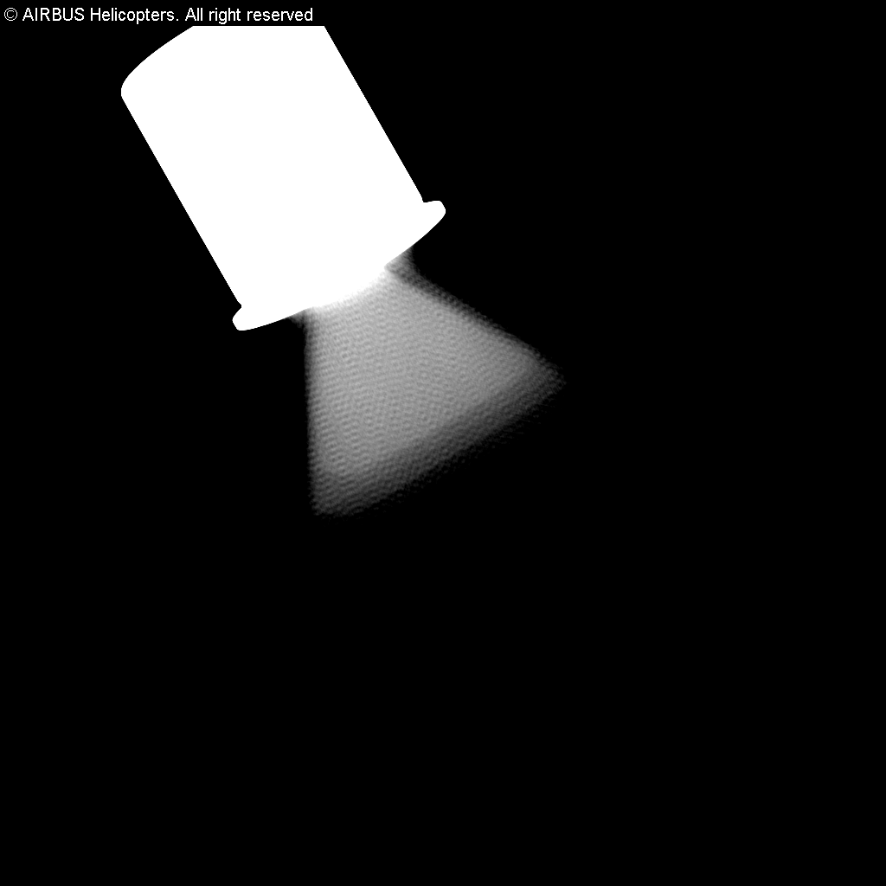
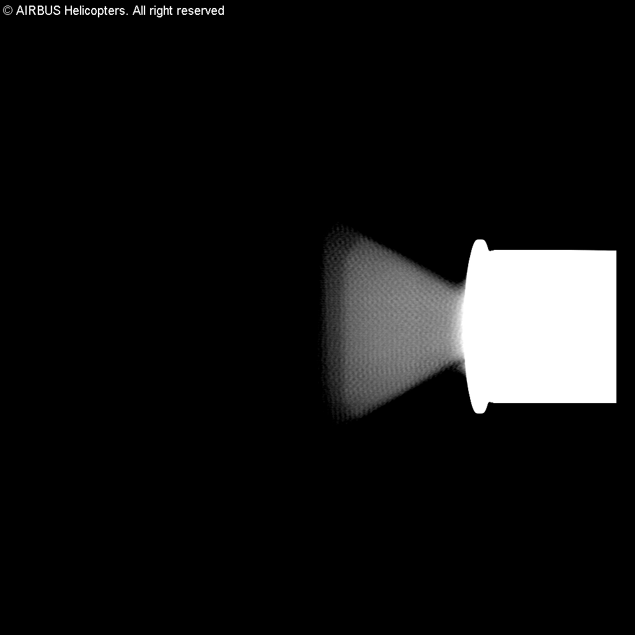
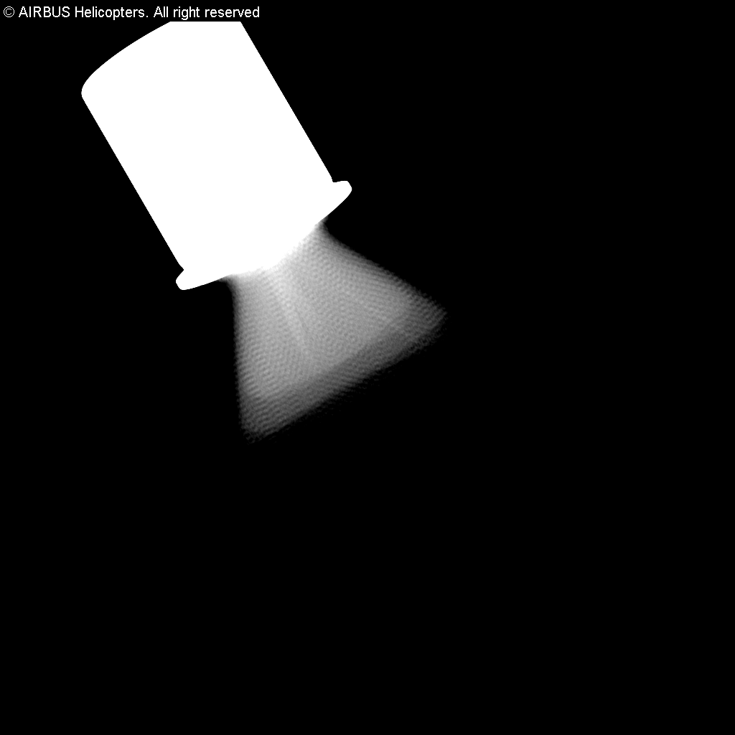
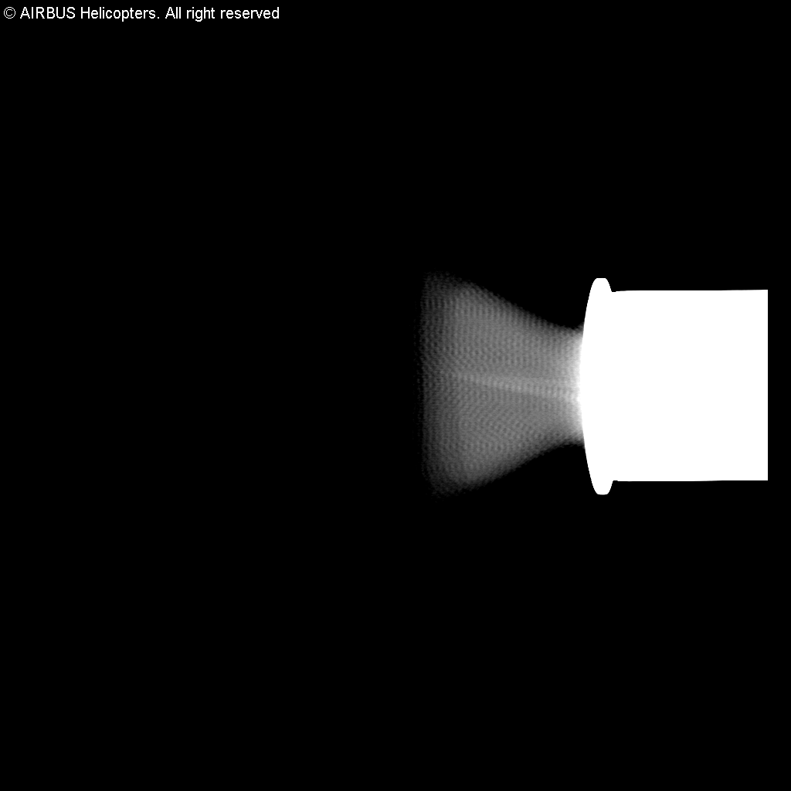
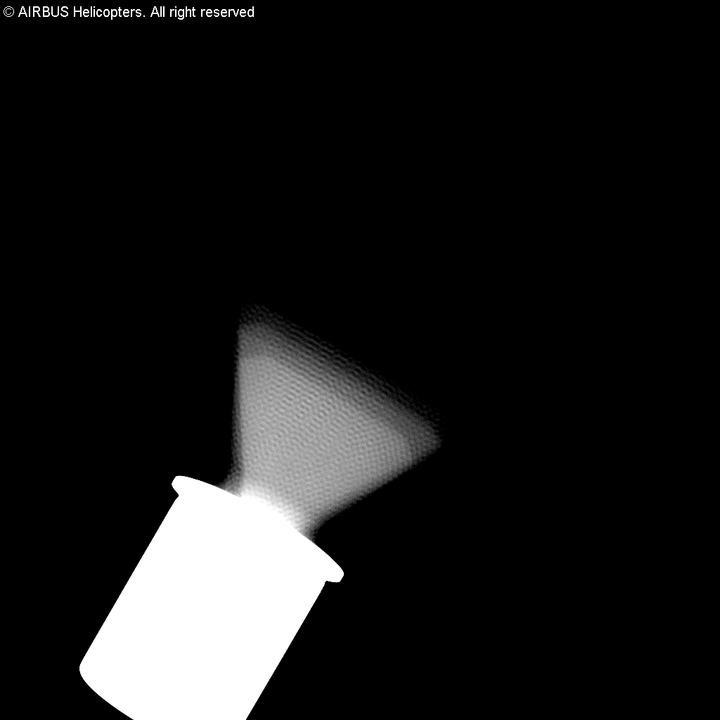
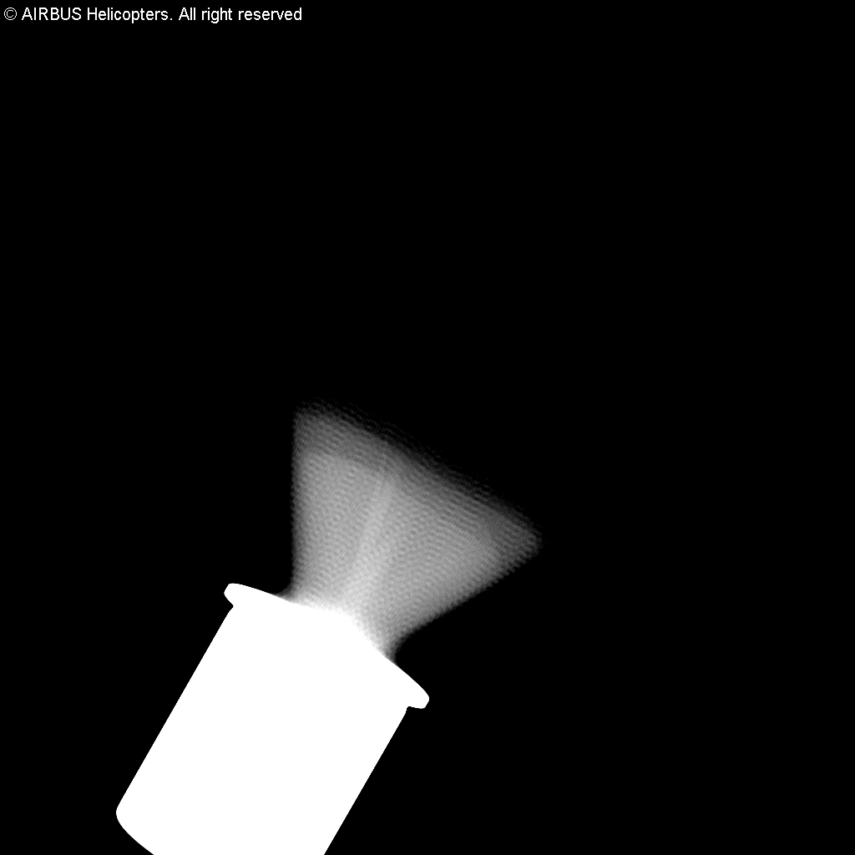
DEFECT DETECTION on RADIOSCOPIES using AI
Images Database
Negatives images :
200 images
without defects
Positives images :
345 images
with defects
27
"This document is the property of AIRBUS, no part of it shall be reproduced or transmitted without express prior written authorization of AIRBUS and its contents shall not be disclosed". © AIRBUS 2024

Slide 28
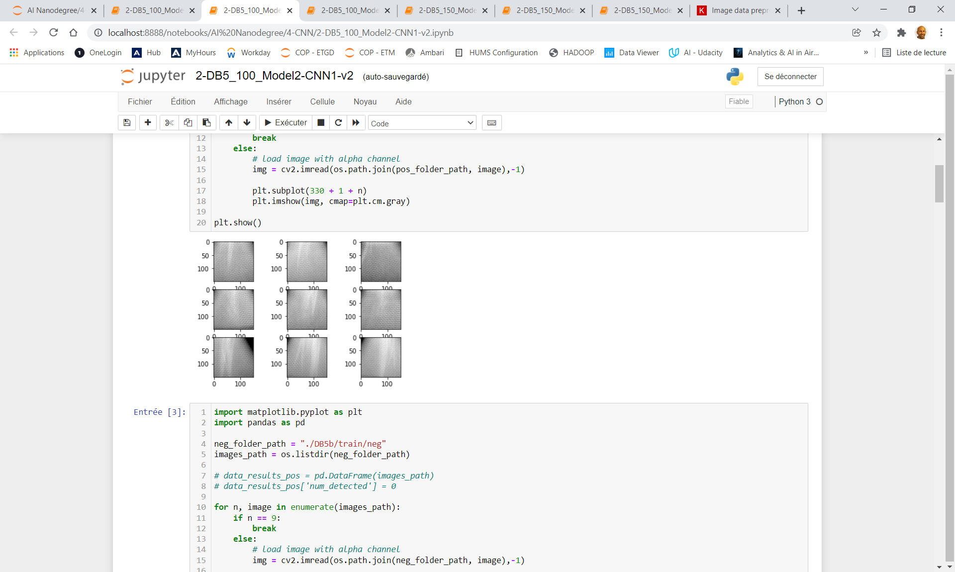
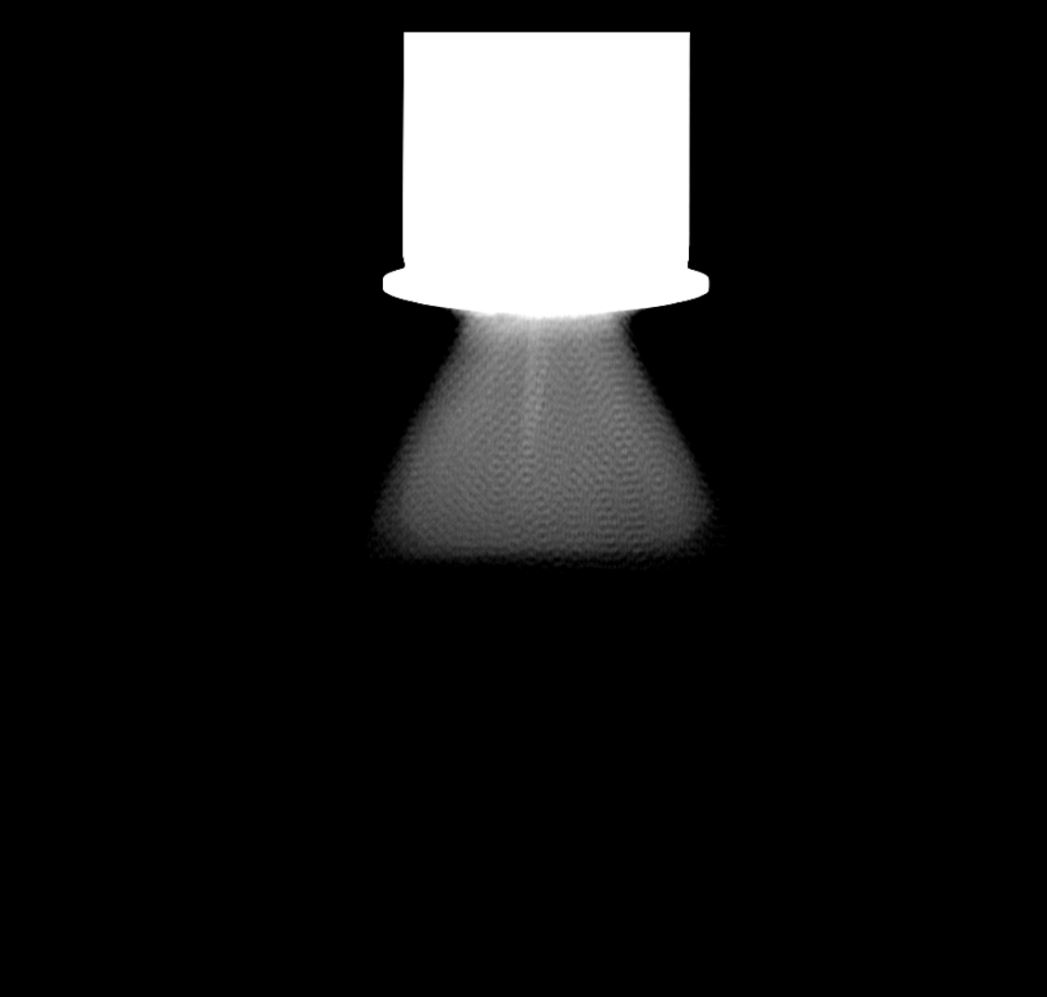
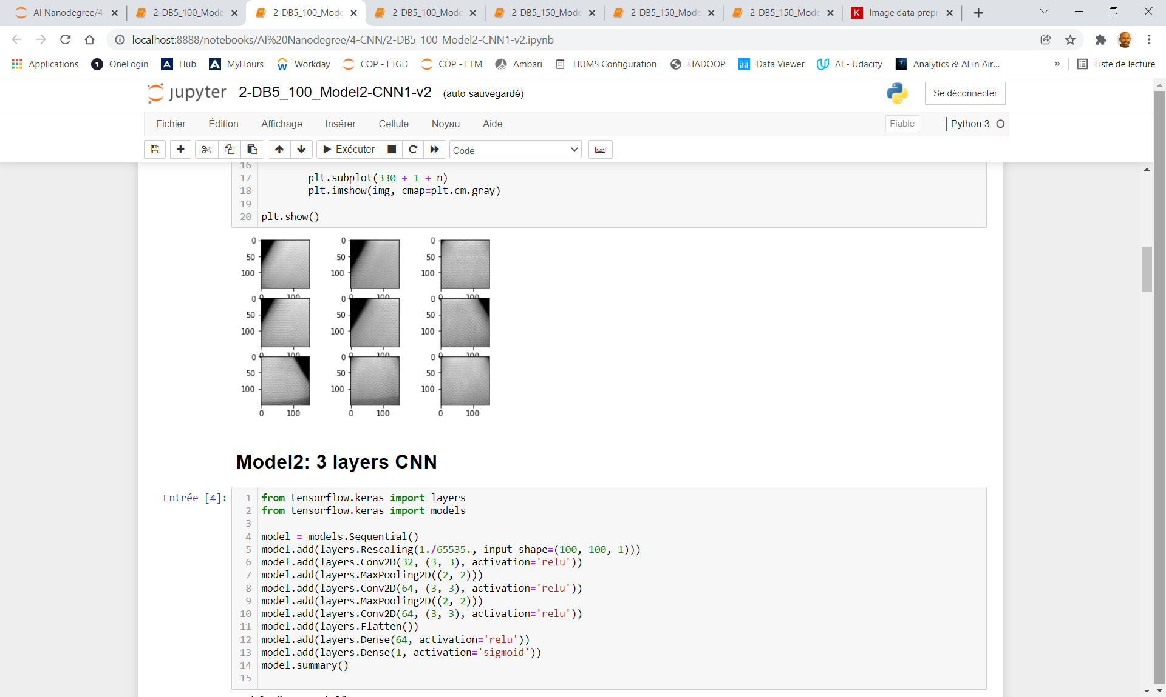
DEFECT DETECTION on RADIOSCOPIES using AI
1 - CLASSIFICATION Model
Positive (defect)
> 98% accuracy for classification
Negative (no defect)
“Full image”
"This document is the property of AIRBUS, no part of it shall be reproduced or transmitted without express prior written authorization of AIRBUS and its contents shall not be disclosed". © AIRBUS 2024

Slide 29
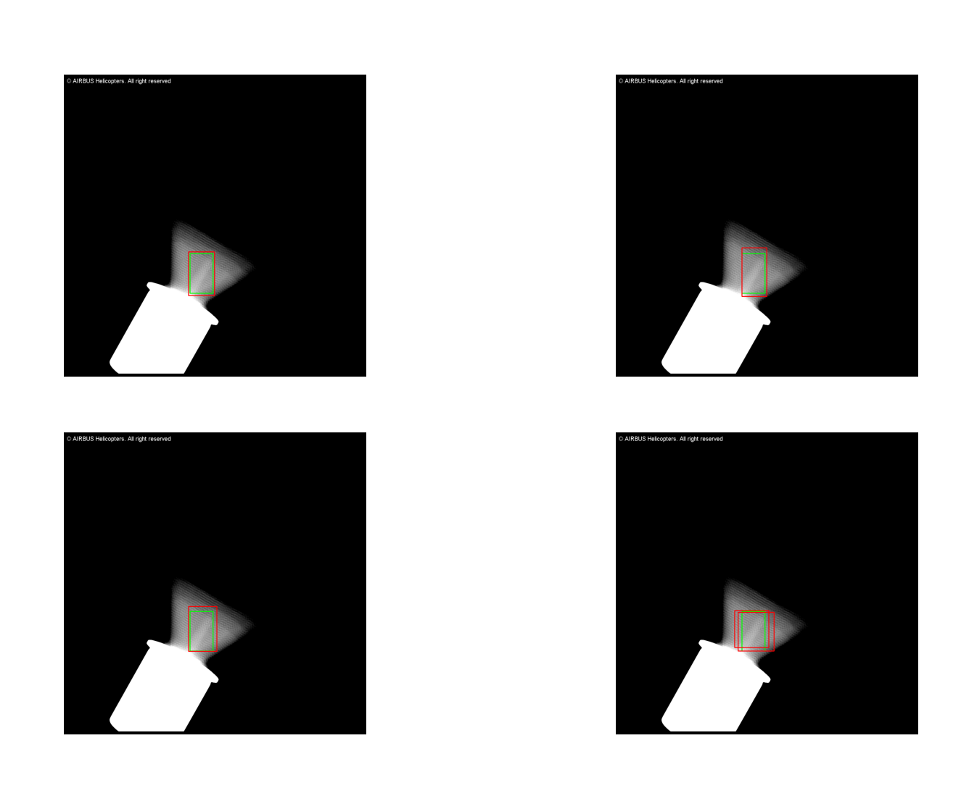
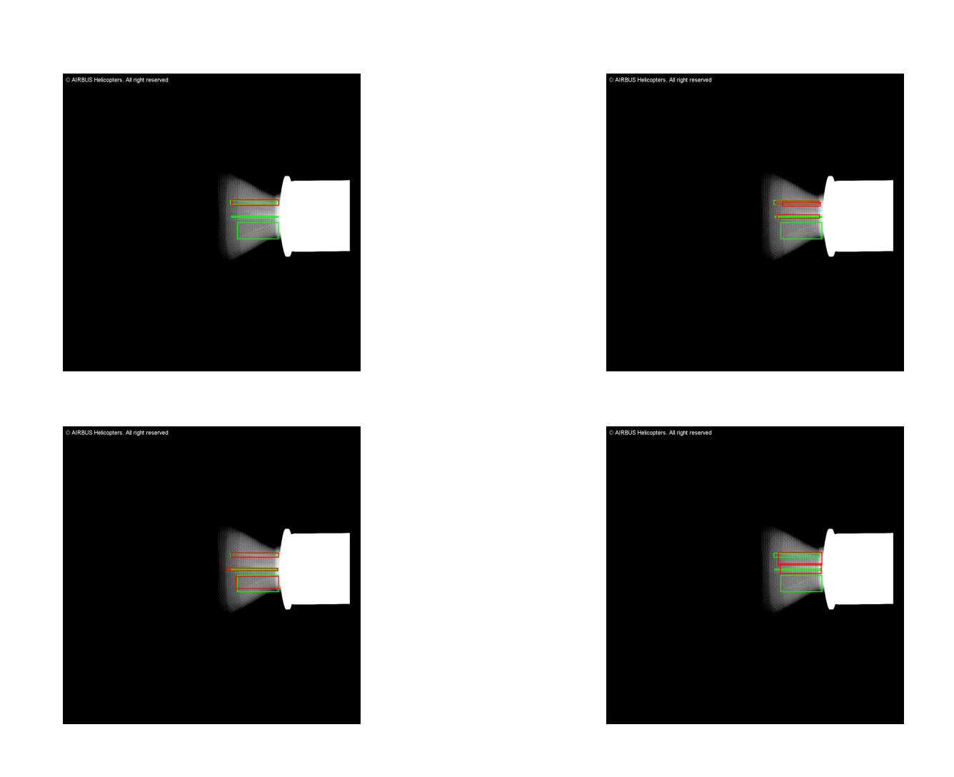
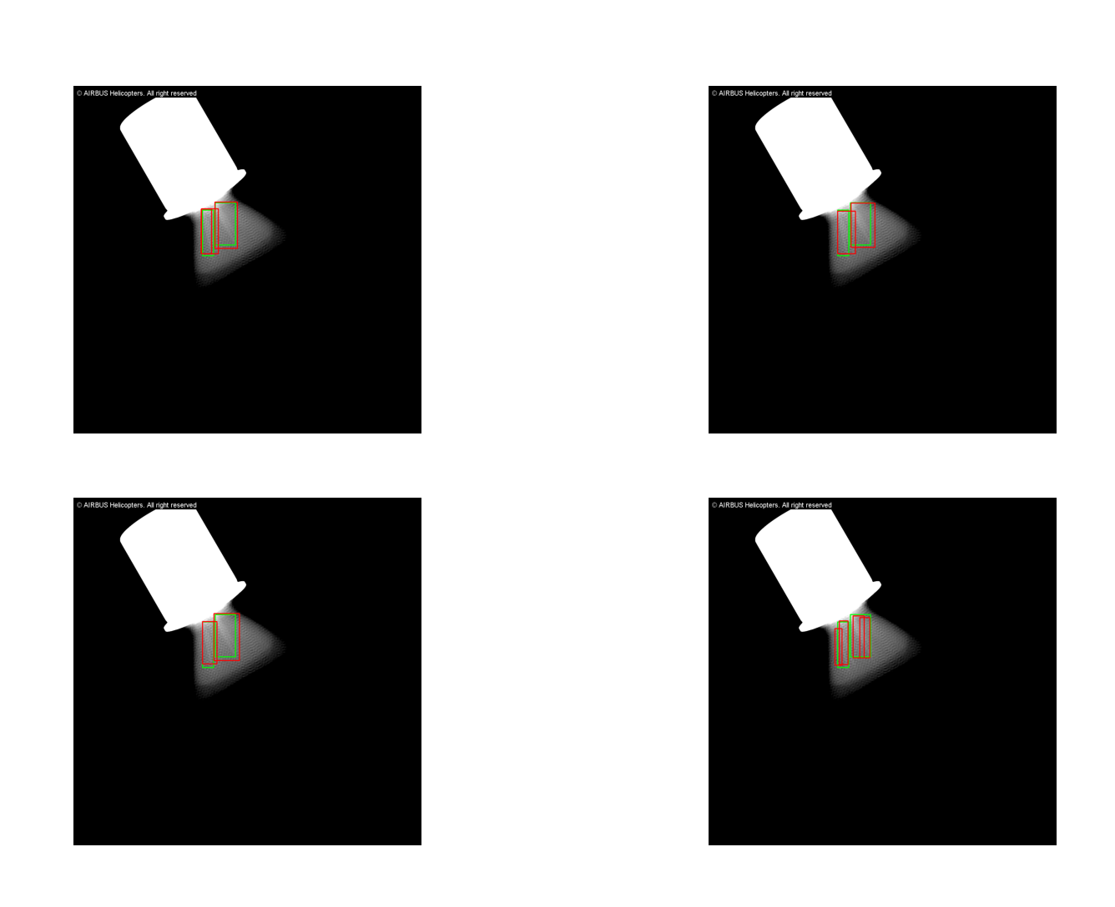
DEFECT DETECTION on RADIOSCOPIES using AI
2- DETECTION BOX Model using YOLO (You Only Look Once)
Ground truth
Results from HACKATHON AI
Prediction
29
"This document is the property of AIRBUS, no part of it shall be reproduced or transmitted without express prior written authorization of AIRBUS and its contents shall not be disclosed". © AIRBUS 2024

Slide 30
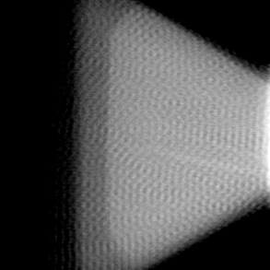
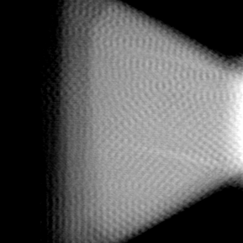
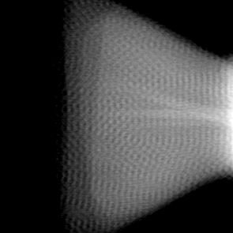
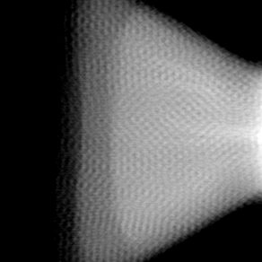
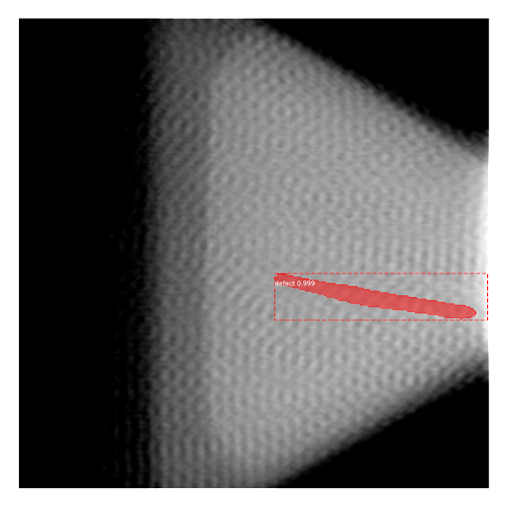
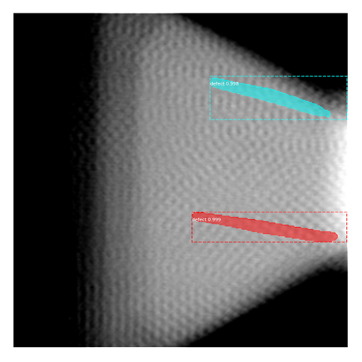
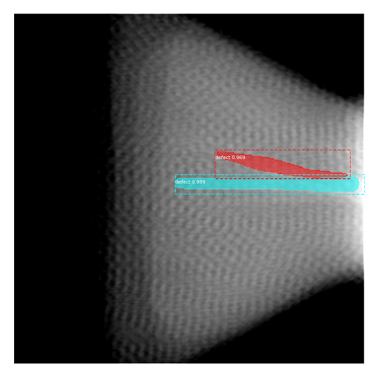

DEFECT DETECTION on RADIOSCOPIES using AI
3 - INSTANCE SEGMENTATION Model using Mask RCNN
Inputs
Predictions
30
"This document is the property of AIRBUS, no part of it shall be reproduced or transmitted without express prior written authorization of AIRBUS and its contents shall not be disclosed". © AIRBUS 2024

Slide 31






Why using Computer Vision Systems ?
Automation and Efficiency
Enhanced Accuracy
Versatility and Wide Application Range
Enhanced User Experience
Cost Reduction
Scalability

